Slide 1
Management
Eleventh Edition
Chapter MH-1
Management History Module
Copyright © 2018, 2016, 2014 Pearson Education, Inc. All Rights Reserved

Slide 2
Learning Objectives
MH1.1 Describe some early management examples.
MH1.2 Explain the various theories in the classical approach.
MH1.3 Discuss the development and uses of the behavioral approach.
MH1.4 Describe the quantitative approach.
MH1.5 Explain various theories in the contemporary approach.

Slide 3
Early Management
The Egyptian pyramids and the Great Wall of China are proof that projects of tremendous scope, employing tens of thousands of people, were completed in ancient times.
Notes:
Who told each worker what to do? Who ensured there would be enough stones at the site to keep workers busy? The answer is managers. Someone had to plan what was to be done, organize people and materials to do it, make sure those workers got the work done, and impose some controls to ensure that everything was done as planned.

Slide 4
Job Specialization
In 1776 Adam Smith published “The Wealth of Nations”
division of labor (job specialization): the breakdown of jobs into narrow and repetitive tasks
Notes:
Smith concluded that division of labor increased productivity by increasing each worker’s skill and dexterity, saving time lost in changing tasks and creating labor-saving inventions and machinery.

Slide 5
Industrial Revolution
Industrial revolution: a period during the late eighteenth century when machine power was substituted for human power, making it more economical to manufacture goods in factories than at home
Notes:
Starting in the late eighteenth century when machine power was substituted for human power, a point in history known as the industrial revolution, it became more economical to manufacture goods in factories rather than at home. These large efficient factories needed someone to forecast demand, ensure that enough material was on hand to make products, assign tasks to people, direct daily activities, and so forth.

Slide 6
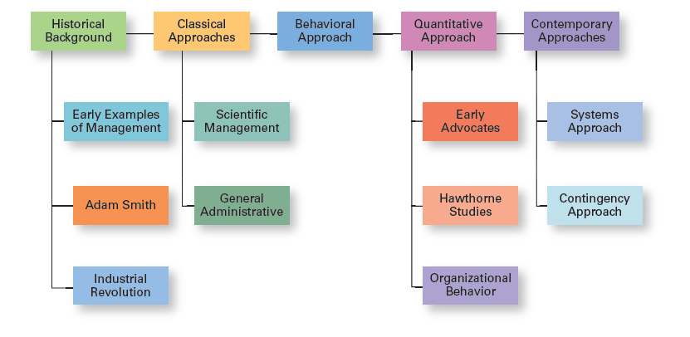
Exhibit MH-1 Major Approaches to Management
Exhibit MH-1 shows the four major approaches to management theory: classical, behavioral, quantitative, and contemporary.
Notes:
In this module, we’ll look at four major approaches to management theory: classical, behavioral, quantitative, and contemporary (see Exhibit MH-1). Keep in mind that each approach is concerned with trying to explain management from the perspective of what was important at that time in history and the backgrounds and interests of the researchers. Each of the four approaches contributes to our overall understanding of management, but each is also a limited view of what it is and how to best practice it.

Slide 7
Classical Approach
Classical approach: first studies of management, which emphasized rationality and making organizations and workers as efficient as possible
Notes:
The first studies of management, often called the classical approach, emphasized rationality and making organizations and workers as efficient as possible. Two major theories comprise the classical approach: scientific management and general administrative theory. The two most important contributors to scientific management theory were Frederick W. Taylor and the husband–wife team of Frank and Lillian Gilbreth. The two most important contributors to general administrative theory were Henri Fayol and Max Weber. Let’s take a look at each of these important figures in management history.

Slide 8
Scientific Management
Scientific management: an approach that involves using the scientific method to find the “one best way” for a job to be done
Notes:
If you had to pinpoint when modern management theory was born, 1911 might be a good choice. That was when Frederick Winslow Taylor’s Principles of Scientific Management was published. Its contents were widely embraced by managers around the world. Taylor’s book described the theory of scientific management—the use of scientific methods to define the “one best way” for a job to be done.

Slide 9
Exhibit MH-2 Taylor’s Scientific Management Principles
Principles
1. Develop a science for each element of an individual’s work to replace the old rule-of-thumb method.
2. Scientifically select and then train, teach, and develop the worker.
3. Heartily cooperate with the workers to ensure that all work is done in accordance with the principles of the science that has been developed.
4. Divide work and responsibility almost equally between management and workers. Management does all work for which it is better suited than the workers.
Notes:
Taylor’s experiences at Midvale led him to define clear guidelines for improving production efficiency. He argued that these four principles of management (see Exhibit MH-2) would result in prosperity for both workers and managers.
Source: F. W. Taylor, Principles of Scientific Management (New York: Harper, 1911).

Slide 10
General Administrative Theory
General administrative theory: an approach to management that focuses on describing what managers do and what constitutes good management practice
Notes:
Fayol wrote during the same time period as Taylor. While Taylor was concerned with first-line managers and the scientific method, Fayol’s attention was directed at the activities of all managers. He wrote from his personal experience as the managing director of a large French coal-mining firm.

Slide 11
Henri Fayol
Principles of management: fundamental rules of management that could be applied in all organizational situations and taught in schools
Notes:
Henri Fayol described the practice of management as something distinct from accounting, finance, production, distribution, and other typical business functions. His belief that management was an activity common to all business endeavors, government, and even the home, led him to develop 14 principles of management—fundamental rules of management that could be applied to all organizational situations and taught in schools. These principles are shown in Exhibit MH-3.

Slide 12
Exhibit MH-3: Fayol’s 14 Principles of Management (1 of 2)
Principles
1. Division of work. Specialization increases output by making employees more efficient.
2. Authority. Managers must be able to give orders, and authority gives them this right.
3. Discipline. Employees must obey and respect the rules that govern the organization.
4. Unity of command. Every employee should receive orders from only one superior.
5. Unity of direction. The organization should have a single plan of action to guide managers and workers.
6. Subordination of individual interests to the general interest. The interests of any one employee or group of employees should not take precedence over the interests of the organization as a whole.
7. Remuneration. Workers must be paid a fair wage for their services.
Notes:
Source: Based on Henri Fayol’s 1916 Principles of Management, “Administration Industrielle et Générale,” translated by C. Storrs, General and Industrial Management (London: Sir Isaac Pitman & Sons, London, 1949).

Slide 13
Exhibit MH-3: Fayol’s 14 Principles of Management (2 of 2)
Principles
8. Centralization. This term refers to the degree to which subordinates are involved in decision making.
9. Scalar chain. The line of authority from top management to the lowest ranks is the scalar chain.
10. Order. People and materials should be in the right place at the right time.
11. Equity. Managers should be kind and fair to their subordinates.
12. Stability of tenure of personnel. Management should provide orderly personnel planning and ensure that replacements are available to fill vacancies.
13. Initiative. Employees allowed to originate and carry out plans will exert high levels of effort.
14. Esprit de corps. Promoting team spirit will build harmony and unity within the organization.
Notes:
Source: Based on Henri Fayol’s 1916 Principles of Management, “Administration Industrielle et Générale,” translated by C. Storrs, General and Industrial Management (London: Sir Isaac Pitman & Sons, London, 1949).

Slide 14
Total Quality Management
Total quality management (TQM): a philosophy of management that is driven by continuous improvement and responsiveness to customer needs and expectations
Notes:
Another area where quantitative techniques are used frequently is in total quality management. A quality revolution swept through both the business and public sectors in the 1980s and 1990s. It was inspired by a small group of quality experts; the most famous was W. Edwards Deming (pictured above) and Joseph M. Juran. The ideas and techniques they advocated in the 1950s had few supporters in the United States but were enthusiastically embraced by Japanese organizations. As Japanese manufacturers began beating U.S. competitors in quality comparisons, however, Western managers soon took a more serious look at Deming’s and Juran’s ideas, which became the basis for today’s quality management programs.
Total quality management, or TQM, is a management philosophy devoted to continual improvement and responding to customer needs and expectations (see Exhibit MH-6). The term customer includes anyone who interacts with the organization’s product or services, internally or externally. It encompasses employees and suppliers as well as the people who purchase the organization’s goods or services.

Slide 15
Exhibit MH-6: What is Quality Management?
Characteristic
1. Intense focus on the customer. The customer includes outsiders who buy the organization’s products or services and internal customers who interact with and serve others in the organization.
2. Concern for continual improvement. Quality management is a commitment to never being satisfied. “Very good” is not good enough. Quality can always be improved.
3. Process focused. Quality management focuses on work processes as the quality of goods and services is continually improved.
4. Improvement in the quality of everything the organization does. This relates to the final product, how the organization handles deliveries, how rapidly it responds to complaints, how politely the phones are answered, and the like.
5. Accurate measurement. Quality management uses statistical techniques to measure every critical variable in the organization’s operations. These are compared against standards to identify problems, trace them to their roots, and eliminate their causes.
6. Empowerment of employees. Quality management involves the people on the line in the improvement process. Teams are widely used in quality management programs as empowerment vehicles for finding and solving problems.

Slide 16
Contemporary Approaches
System: a set of interrelated and interdependent parts arranged in a manner that produces a unified whole
Closed systems: systems that are not influenced by and do not interact with their environment
Open systems: systems that interact with their environment
Notes:
Most of these earlier approaches focused on managers’ concerns inside the organization. Starting in the 1960s, management researchers began to look at what was happening in the external environment outside the boundaries of the organization. Two contemporary management perspectives—systems and contingency—are part of this approach. Systems theory is a basic theory in the physical sciences, but had never been applied to organized human efforts.
A system is a set of interrelated and interdependent parts arranged in a manner that produces a unified whole. The two basic types of systems are closed and open. Closed systems are not influenced by and do not interact with their environment. In contrast, open systems are influenced by and do interact with their environment. Today, when we describe organizations as systems, we mean open systems.

Slide 17
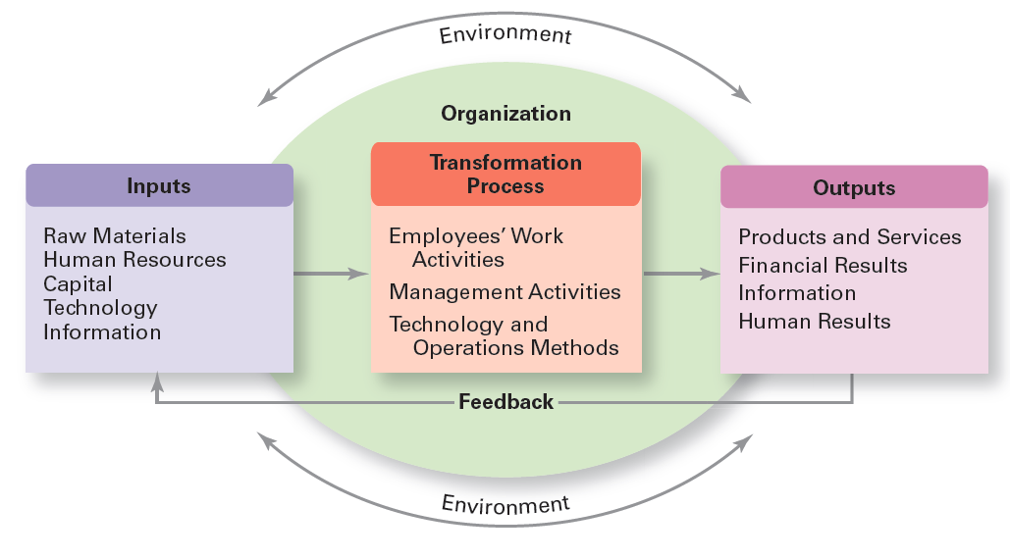
Exhibit MH-7 Organization as an Open System
Exhibit MH-7 shows a diagram of an organization from an open systems perspective.
Notes:
As you can see, an organization takes in inputs (resources) from the environment and transforms or processes these resources into outputs that are distributed into the environment. The organization is “open” to and interacts with its environment.

Slide 18
Contingency Approach
Contingency approach: a management approach that recognizes organizations as different, which means they face different situations (contingencies) and require different ways of managing
Notes:
Different and changing situations require managers to use different approaches and techniques. The contingency approach (sometimes called the situational approach) says that organizations are different, face different situations (contingencies), and require different ways of managing.

Slide 19

Copyright

